Slide 1



Zenith Properties
COMMUNITY INFORMATION SESSION
August 21, 2025

Slide 2


WELCOME

Slide 3


TONIGHT
Share the status of the Zenith Properties / Historic Masonic Home
Hear from you
Outline what’s next
Notes:
S&R do this portion
Housekeeping – this is being recorded and will be posted to website and City channel

Slide 4
TO KEEP IN MIND
Share airtime: Everyone participates; no one person dominates.
Time boxing: Don’t get offended if you are asked to wrap up your thought – we want to make this a space where everyone can be heard.
Be curious: Ask questions, seek to understand.
Reject the culture of blame: Be tough on ideas, gentle on people.
Put yourself in someone else’s shoes: Work to understand and value the assumptions, opinions, and ideas of others.

Slide 5
KATHERINE CAFFREY
City Manager

Slide 6
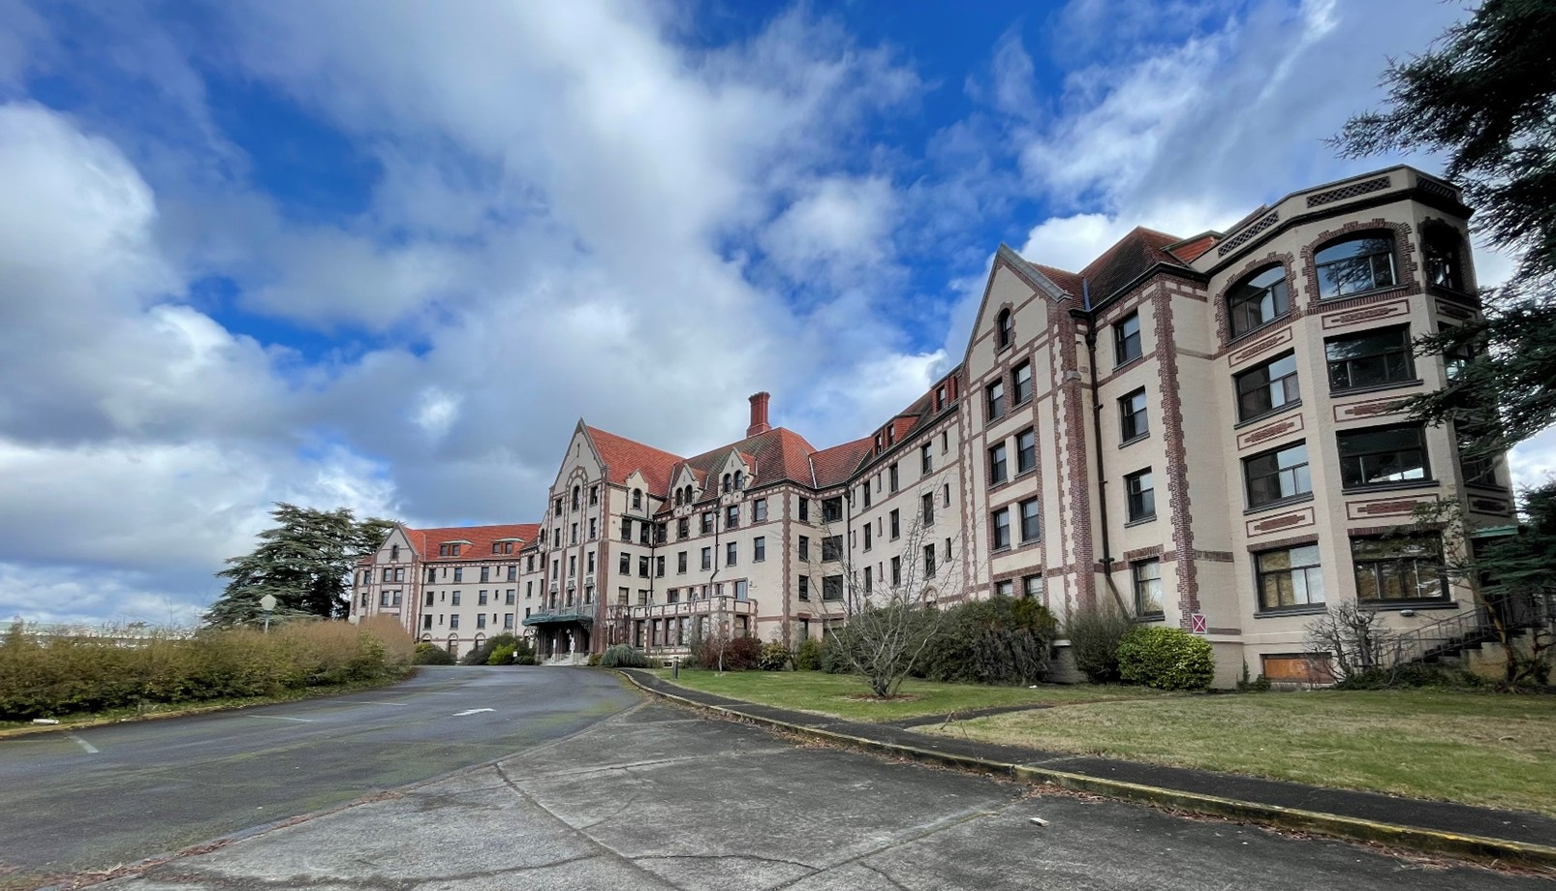
Masonic Home
Landmark on the Sound
Notes:
Many of you were at the Council meeting on the 7th and have read the information we’ve already shared, so I won’t repeat all of that. Instead, I want to talk about why I felt this meeting was important.
Almost exactly one year ago, I stood in this very auditorium interviewing for this job. I remember standing at a table in the back corner and listening as community members came up to me. Over and over I heard the same message: frustration with the City for not communicating enough, for not being transparent, for not being trustworthy.
That stuck with me. Because those values—openness, accessibility, and trust—are what I believe in. From day one, I’ve worked hard to repair relationships, to build trust between our staff and the public, and to ensure you have visibility into the decisions being made—even when those decisions are not what you hoped for.
That is why I felt this meeting was important: to give you information in a clear and open way, and to create space to listen. Tonight’s presentation is shorter than the Council’s on the 7th, but it responds directly to the questions and concerns we’ve seen circulating in the community that we can answer at this point in the legal process.

Slide 7
APPEAL UPDATE
Appeal of the City’s Determination on the Final EIS has been filed
Bricklin and Newman (law firm) on behalf of several community organizations
Appeal hearing:
Date will be published on City website when set by the Hearing Examiner
Open to the public
Will provide opportunity for thorough review of City’s process and decision by independent third-party administrative law judge
🡪 Pending litigation means some limits to what can be discussed/address tonight
Notes:
The appeal period closed on the 18th, and an appeal was filed by the law firm Bricklin and Newman. This firm specializes in historic preservation, so we expect a detailed review of the City’s process and decision that led to this point.
The appeal will be heard by the Hearing Examiner—an independent judge who reviews the facts and determines whether the City acted properly under the law in approving both the Environmental Impact Statement and the demolition permit. The hearing will be open to the public, and we’ll share the date once it is scheduled.
Because this is now in the legal appeal process, there are limits to what we can discuss tonight. Our goal is to share the facts about how the decision was made, while leaving the legal arguments for the Hearing Examiner to consider at the appropriate time.

Slide 8
2013 – 2025: 12 YEARS EXPLORING PRESERVATION POSSIBILITIES
PRESERVATION PROPONENTS
CITY OF DES MOINES
PUBLIC AND PRIVATE ENTITIES
Explored incentives and subsidies
Met with multiple prospective buyers
Engaged state legislators
Sought viable plans for preservation and funding
Explored Federal Historic Tax Credits and State Special Tax Valuation programs
Notes:
Since 2013, the City has supported preservation and redevelopment options for the main structure.
• City staff met with numerous potential buyers to explore preservation and reuse options for the main structure.
•We have explored preservation strategies with our state legislators.
•And we have looked into federal and state preservation programs.
Preservation proponents in our community have also sought ways to preserve the building.
•Despite efforts over the course of 12 years, none of these efforts have yielded a viable pathway to preservation and reuse of the main structure.

Slide 9
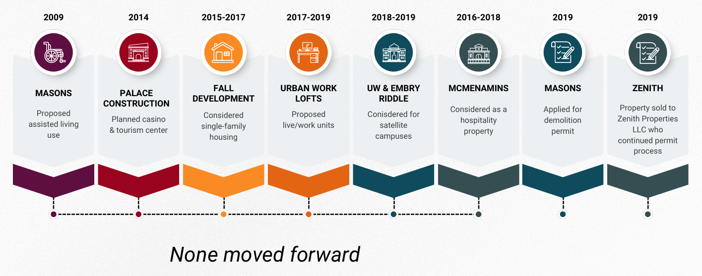
PRESERVATION EFFORTS
WELCOME
Notes:
Let me briefly walk through some of the key proposals we’ve seen over the years:
Back in 2009, the Masons proposed turning the building into assisted living units, but determined it wasn't financially feasible. the Masons then decided to sell the property.
In 2014, Palace Construction considered developing a casino and tourism center, but backed out due to the high remodeling costs.
Between 2015 and 2017, Fall Development looked into creating a single-family residential project, but that effort was also abandoned.
From 2017 to 2019, Urban Work Lofts proposed converting the building into live/work spaces, but again, the cost of rehabilitation made it infeasible.
Additionally, in 2018, the City and our state legislative representatives reached out to UW and Embry Riddle to see if this may be a suitable satellite campus– and the parties were not interested in pursuing this.
I've been asked about McMenamin’s—an organization well-known for restoring historic properties—explored the site but ultimately chose not to invest.
Ultimately, the Masons concluded preservation and reuse was not a viable option for any buyer and applied for a demolition permit.
Zenith Properties LLC bought the property in 2019 and continued the demolition permit.

Slide 10
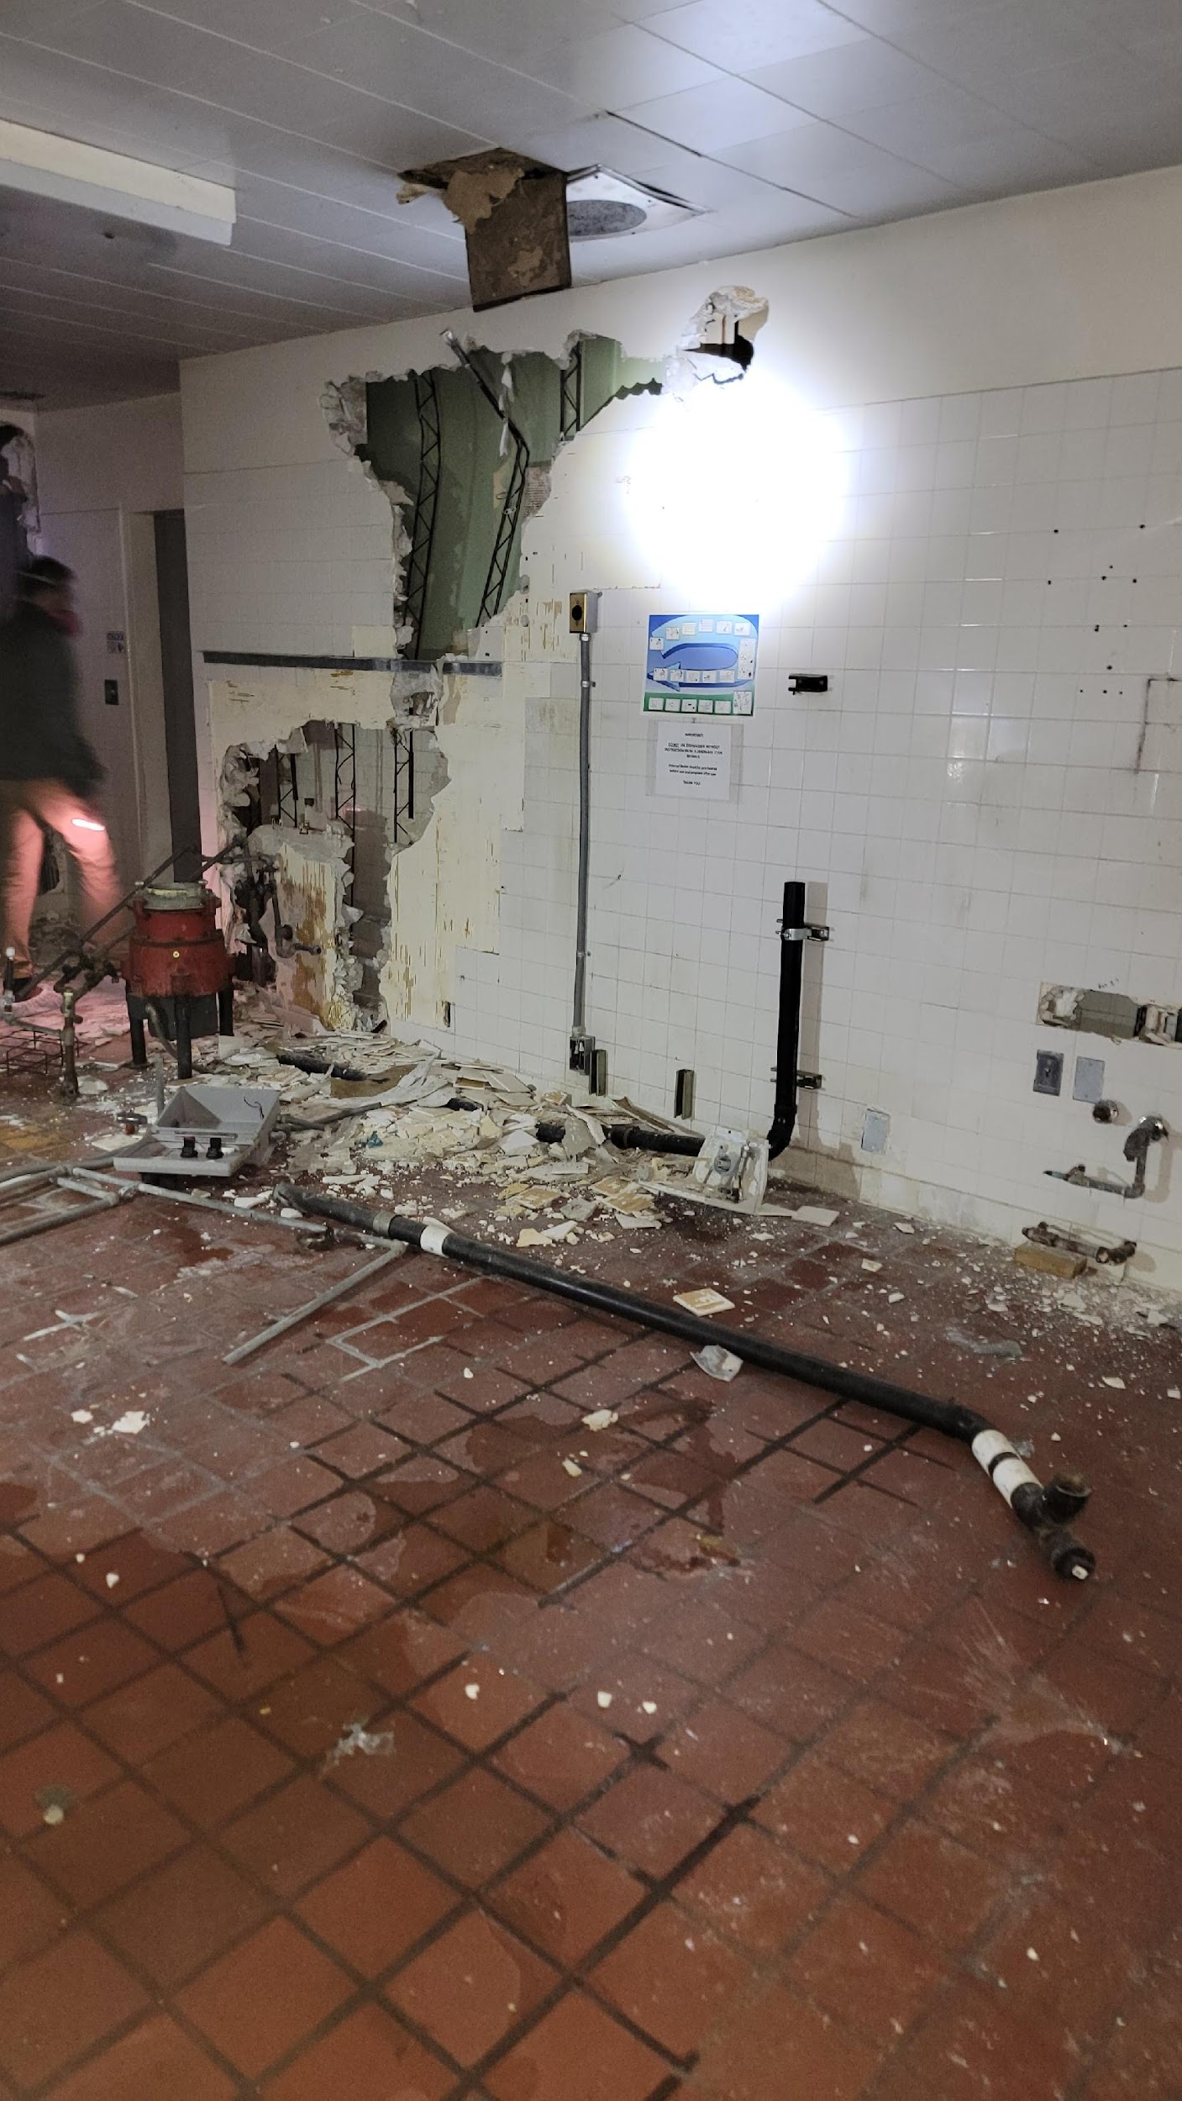
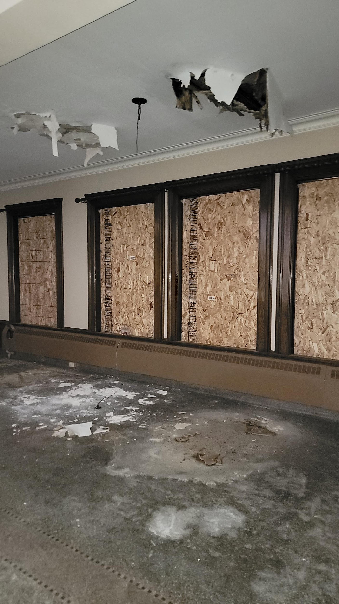
Notes:
Site visit 1/16
Wear PPE due to health concerns when walking through building
For an uninhabited structure, City code requires the property be maintained, and secured. The City required Site secured with fencing and onsite security.
Boarded up windows and other security function to minimize attractive nuisances.

Slide 11
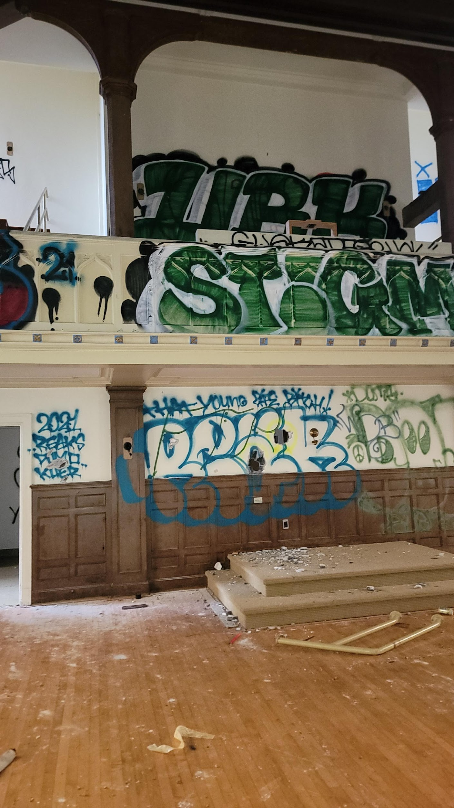
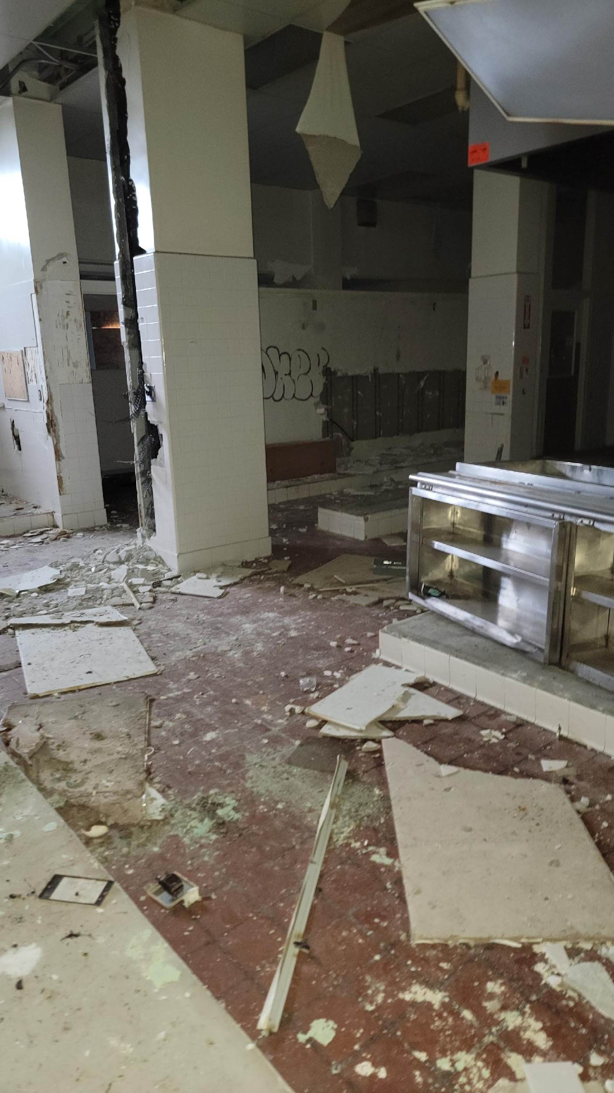
Notes:
This is another example of the vandalism and deterioration in the building. Unfortunately, this will continue without focused restoration efforts.
Transition to Rebecca

Slide 12
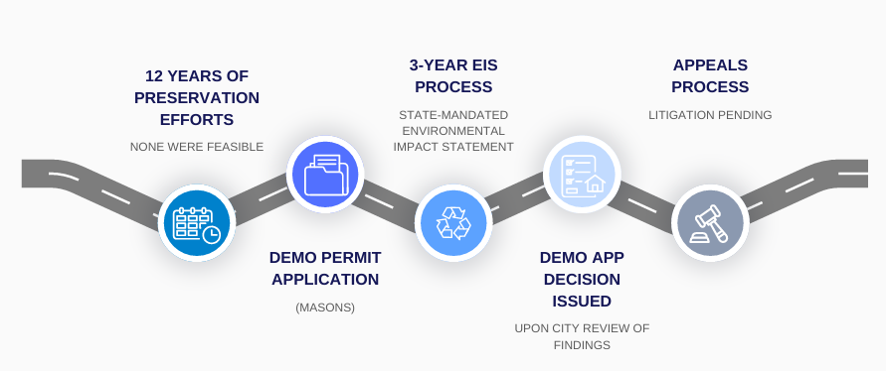
TIMELINE TO TODAY
WELCOME
Notes:
REBECCA
In 2019, the Freemasons of Washington submitted a demolition permit application, that was subject to Environmental Review
After the Property was purchased, the application was transferred to Zenith Properties LLC.
An EIS is required under the State Environmental Policy Act (SEPA) when a project may cause significant environmental impacts.
Process is prescribed by State law
We received a question about who the lead agency is vs the City– the City is the lead agency for this process. The SEPA official is the Community Development Director, which is myself. These roles are dictated by State law and City code.
The EIS report has been completed– that is what was posted July 31. The decision on the demo permit was made on August 8, and the appeal period began and concluded on August 18.

Slide 13
ALTERNATIVES EXPLORED
As required by state law:
Additional alternatives pursued by City:
NO ACTION
PRESERVATION
DEMO BY PROPERTY OWNER
Mothball
Adaptive re-use 1
Adaptive re-use 2
Notes:
REBECCA
When a proposal is for a private project on a specific site, as we have here, the lead agency is required to evaluate two alternatives: 1.) taking no action and 2.) the action requested in the permit application.
The City asked the EIS consultants to include a third alternative in the EIS: preservation.
The Zenith EIS examined three alternatives:
No Action – This alternative would leave the structures as the are. It would be neither demolished or restored. We have received some questions from the public about “why didn’t we look at just keeping the structure there?”-- The report does look at this, both as No action and as Preservation. It is discussed as part of Alternative 2 Historic Preservation.
Demolition, as requested by the property owner
Preservation and reuse: The Preservation option is broken into three preservation options.
Mothball the building or preserve the vacant building
Restore and redevelop the main structure for future use. This is identified in the EIS as “Adaptive Reuse.”
In response to community feedback on the Draft EIS, the City requested analysis of an expanded adaptive reuse option, which was added in the Final EIS.

Slide 14
Financial Feasibility Analysis
 | Multi-family housing | Senior Housing | Mid-scale Hotel | Upscale Hotel
Gap after subsidies | $51 million | $47 million | $62 million | $53 million
Current Market Rental Rate | $1,850/mo 1,000 sq ft unit | $2,350/mo 1,000 sq ft unit | $100 average daily rate | $165 average daily rate
Needed Rental Rate | $10,400/mo 1,000 sq ft unit | $10,400/mo 1,000 sq ft unit | $290 average daily rate | $375 average daily rate
Rental Rate Percent Above Market Rate | +560% | +445% | +290% | +230%
The rent and daily rates for potential uses far exceed the market in the Seattle metro area.
Notes:
REBECCA
The EIS concluded that both preservation options were not financially feasible.
Here are some figures that illustrate the financial barriers. We looked at 4 potential uses in the feasibility study because they were determined to be the most feasible. As you can see in the first line, there is a significant gap between the cost to rehab the building and the revenue from rentals.
Click
For example, the average monthly rent for a 1000-square foot apartment or senior living would be more than $10,000 a month.
Click
For the Hotels the average daily rates would need to be more than 200% above market rate.
Based on the comments received during the comment period we looked at additional studies that are included the Final EIS of whether development of the eastern portion of the property could subsidize the cost to redevelop the main building. These studies are contained within the four of the appendices in the FEIS. Even with development of apartments on the eastern portion, in order to produce enough revenue to fund the preservation and reuse of the main building, the rents would have to be between $6,000 to $8,000 a month, which still dramatically exceeds current market rates.

Slide 15
Additional Preservation Option
 | Lower cross-subsidy | Higher cross-subsidy
Gap after subsidies | $51 million | $47 million
Current Market Rental Rate | $2,150/mo $2.35 per sq ft | $2,150/mo $2.35 per sq ft
Needed Rental Rate | $6,130/mo or $7.20 per sq ft | $7,990/mo $9.24 sq ft
Rental Rate Percent Above Market Rate | +285% | +372%
Notes:
This chart shows that whether you were trying to subsidize the higher or lower amount depending on the proposed reuse of the building the rents would still be over 285% above market rate to fund the reuse of the lodge building.

Slide 16
MITIGATION MEASURES
Protection of archaeological and historic resources
Preservation of artifacts inadvertently discovered
Architectural salvage work before demolition
$1.16M dedicated to preserving City-owned historically significant structures
Maintenance of publicly accessible space honoring site’s history (funded by developer)
Limiting demolition and construction impacts
Construction Noise Reduction Plan & Traffic Disruption Management Plan
Limits to sediment inputs to water
Protection of bald eagle nests
Cleared areas replanted with native species to stabilize soils
Additional detail in PPT appendix..
Notes:
REBECCA
Mitigation Measures under the Demolition Alternative include Mitigation for Traffic, Water Quality, Noise, Erosion Control, Plants & animals, and historic resources.
The Historic Resources mitigation includes payment of $1.2 million to a dedicated preservation fund established and managed by the City of Des Moines. This is used exclusively for the repair and rehabilitation of City-owned or managed landmarks or Properties of Local Significance such as this building and the ones around this or the Field House.

Slide 17
COMMUNITY INPUT
Public comment periods on the draft EIS included:
May 3-June 2, 2022
July 27-August 25, 2022
Jan. 9-Feb. 22, 2024
Jan. 31, 2024 public meeting
314 letters, emails and verbal statements were collected, generating 728 distinct comments or questions
Additional analysis of historic preservation options conducted in response to public comments on draft EIS
Notes:
KATHERINE
The city received 314 letters, emails, and statements. Within those there were 728 distinct comments or questions that were responded to in the final EIS in Appendix L.

Slide 18
COMMUNITY VOICE - IMPACT
YOU SAID:
Conduct additional analysis
Mitigation payment to City was inadequate
History of building and site should be recognized & honored
Trees need to be protected
IMPACT:
Additional preservation option analyzed
Mitigation dollar amount increased by 67%
Publicly accessible historical Installation
Tree Permit: survey & protective fencing
Notes:
A few examples of how the feedback and comments we received from the public directly influenced the analysis done and final report
•The City heard a lot of comments asking for additional analysis—especially related to could other development on the property offset costs for the main building—so that led to the additional studies. So, the specific public input we received is what directly led us to do more analysis, dig deeper and ensure the report was thorough and looked at the most feasible development alternatives.
There were comments made that the initial proposed mitigation payment to the City was inadequate– so that has been increased by 67%
Building is beloved by the community, and so many community members have memories of being there or going to events there– so it is important to recognize the significance of the building and the role it has played in DM’s history—> developer is required to construct and maintain a publicly accessible area– such as a greenspace– that recognizes the history of the building and what was there. Ideally, this would be able to include perhaps portion of the original building– to help illustrate the character of the building.

Slide 19
DECISION AND RATIONALE
EIS REVIEW
DELIBERATION BASED ON EIS FINDINGS
DEMO PERMIT DECISION ISSUED AUG 8
Notes:
The decision to approve the demolition of this structure was not made quickly or easily. It followed more than three years of process, multiple rounds of public engagement, and a thorough environmental review that was questioned, challenged, and critically examined before being finalized.
The purpose of an EIS to guide the lead agency’s decision
Our community development director is our city’s SEPA official. She oversaw and guided the EIS process. RD arrived about a year ago– so two years into the process. Her role is to ensure the report is thorough, objective and fair– and then to use those findings to make an informed decision about a course of action. I made clear that I wanted her decision to be based on the findings of the EIS. She did. I support her decision.
I’d like to share about my decision making process and values.
First and foremost, as a city we have to follow local, state and federal law. There are legal limits to government control over private property. The state EIS process is one part of that system of laws that protect your wellbeing as a member of the greater community as well your rights as a property owner.
Second, as CM, I take very seriously my obligation to be a good steward of your dollars. It is my responsibility to make sure our City is fiscally sound and that this community has the services it needs and wants. Sometimes that means I have to make a decision that is not popular but that complies with the law.
When you don’t follow the law, that can lead to litigation that can be devastating for a city. You may have heard that the city of Cle Elum recently declared bankruptcy because it lost a lawsuit brought by a developer over a permitting issue and it could not pay the resulting costs. I do not want to let that happen to Des Moines on my watch.
Unfortunately, in this situation, the City was faced with a dilemma that has remained unsolved despite more than a decade of effort.
Finally, regarding the appeal fee– I have received some questions and heard concerns about the cost– to file an appeal is a little more than $900. The appeal fee is intended to cover the cost of teh appeal– meaning the administrative hearing. The fee is uniform for all appeals of administrative decisions that are heard by the HEaring Examiner, which is an Administrative Judge. In this specific situation, given the complexity of the process that is being appealed, the appeal fee will only cover a small portion of the cost of the appeal. The City’s appeal fee is commensurate with surrounding jurisdictions fees for similar processes.

Slide 20
FUTURE DEVELOPMENT
Plans for future development are unknown.
  The law does not require the property owner to declare future development plans, if any.
If property owner chooses to pursue future development, it will be subject to:
City zoning requirements.
All state and local law, including SEPA.
  May trigger a new EIS process.
Process will include public input.
Notes:
I share the community’s frustration that we do not know the property owner’s future plans for the property. Unfortunately, the City cannot compel a private property owner to create or share any plans they may have outside of the scope of the requested action. We lack legal grounds to withhold a permit decision due to the absence of future plans.
However, the property owner will have to submit detailed plans for any future development, and those plans will be subject to City regulations and a full approval process that includes the opportunity for public input. There are zoning requirements, potentially another SEPA process, etc. If the property owner were to create plans for this property that do not align with the current zoning, then a request to the City Council would need to be made for the zoning change.
Another question we’ve gotten about future development is– if the building is demolished, how soon would the City receive the plan for the future project. At this time, we have no idea. As with all private property, the City does not control nor can it dictate the timing of any future development.

Slide 21
GALLERY WALK
Community
Input

Slide 22
What is important for the property owner to know:
…about this property
…about this community
…about you

Slide 23
KEY THEMES
Notes:
R&S will identify common themes from the gallery walk, share them out verbally
R&S will invite participants to share any additional thoughts and questions
Pending Tim guidance….we will set parameters for what can be answered vs.not
(reiterate TP re: pending litigation…acknowledge limits on what can be discussed in real time, understand not super satisfying)
Gently limit speakers to 3 minutes via time boxing norm

Slide 24
WHAT’S NEXT
All input from tonight will be documented and catalogued
Construction activity is paused while appeal is pending
Date of appeal will be published to website once set
Notes:
R&S will wrap up

Slide 25
FOR MORE INFORMATION
Project Website: http://www.desmoineswa.gov/zenitheis
Project email: ZenithEIS@desmoineswa.gov
Hard copies of FEIS for viewing:
    City Hall
    21630 11th Avenue S, Suite D
    Mon.-Fri. 8 a.m. to 4 p.m.
    Des Moines Public Library
    21620 11th Avenue S
    Woodmont Public Library
    26809 Pacific Hwy S
Notes:
R&S will wrap up

Slide 26
THANK YOU

Slide 27
APPENDIX

Slide 28
Demolition Mitigation Measures
Protection of archaeological and historic resources
  Implement plan for inadvertent discovery of artifacts.
  Prepare Historic American Buildings Survey (HABS) Level I.
  Allow access for architectural salvage work before demolition.
  Require on-site location for an appropriately scaled historical interpretation installation, if property is redeveloped.
  Payment of $1,161,560 to a dedicated preservation fund established and managed by the City of Des Moines.
    Exclusively for the repair and rehabilitation of City-owned or managed landmarks, Properties of Local Significance, or National Register of Historic Places-listed properties (Beach Park).
Notes:
RD
Mitigation Measures under the Demolition Alternative include:
Implementation plan for inadvertent discovery of artifacts
Prepare Historic American Buildings Survey (HABS) Level I
Allow access for architectural salvage work before demolition
Require on-site location for an appropriately scaled historical interpretation installation, if property is redeveloped.
Payment of $1.2 million to a dedicated preservation fund established and managed by the City of Des Moines.
This is used exclusively for the repair and rehabilitation of City-owned or managed landmarks, Properties of Local Significance, or National Register of Historic Places-listed properties- such as the City's Beach Park

Slide 29
Demolition Mitigation Measures
Construction/Demolition Impacts
Noise:
  Prepare and implement a Construction Noise Reduction Plan.
Soils/Erosion Control:
  Measures to limit sediment inputs to waters during and after construction.
Plants and Animals:
  Pre-construction bald eagle nest surveys to determine the presence of active bald eagle nests on or nearby the site.
  Implementation of the National Bald Eagle Management Guidelines (2007) if present.
  Trees not marked for removal protected to the maximum extent possible with tree fencing and other means.
Notes:
RD
Prepare and implement a Construction Noise Reduction Plan.
Measures to limit sediment inputs to waters during and after construction.
Pre-construction bald eagle nest surveys to determine the presence of active bald eagle nests on or nearby the site.
Implementation of the National Bald Eagle Management Guidelines (2007) if present.
Trees not marked for removal protected to the maximum extent possible with tree fencing and other means.

Slide 30
Demolition Mitigation Measures
Construction/Demolition Impacts
Water Quality:
  Implement Stormwater Pollution Prevention Plan (SWPPP).
  Cleared areas replanted with native species to stabilize soils.
Traffic
  Implement a Construction Management Plan (CMP), including truck haul routes.
Notes:
RD
Implementation of a Stormwater Pollution Prevention Plan (SWPPP)
Cleared areas replanted with native species to stabilize soils.
Implementation of a Construction Management Plan (CMP), including truck haul routes.

Slide 31
